Slide 1

Deep Learning Techniques for Gesture Recognition: Dealing With Inactivity
Matteo Drago, Riccardo Lincetto
Dept. of Information Engineering, University of Padova, Italy
Prof. Michele Rossi
matteo.drago@studenti.unipd.it
riccardo.lincetto@studenti.unipd.it
September, 5, 2018

Slide 2
Outline
Introduction
Dataset description
Related Work
Our proposal
Discussion of results
Conclusion and future works

Slide 3
Introduction
Human Activity Recognition:
Visual detection from images and video
Gesture recognition from sensor-based data
In the past decade, many models have been designed for time series classification.
Main problems:
LACK of BENCHMARKING DATASET to compare different solutions
ABSENCE of DETAILS in most of the models presented in the literature

Slide 4
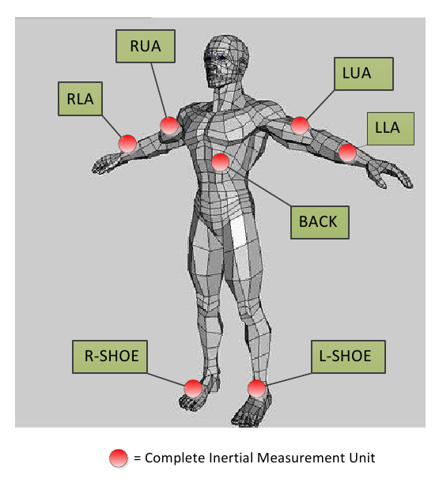
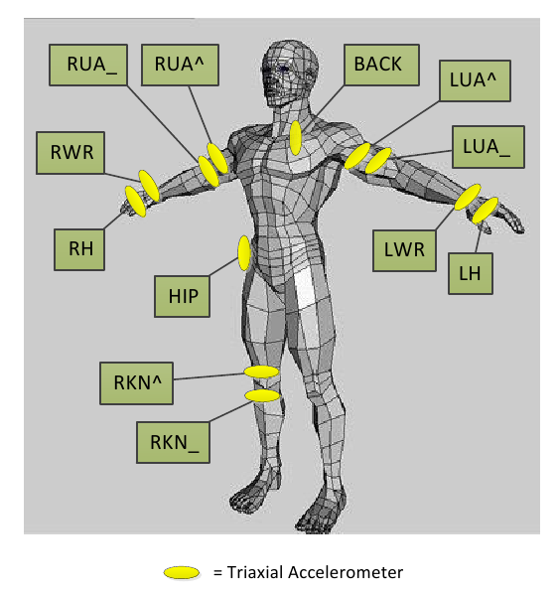
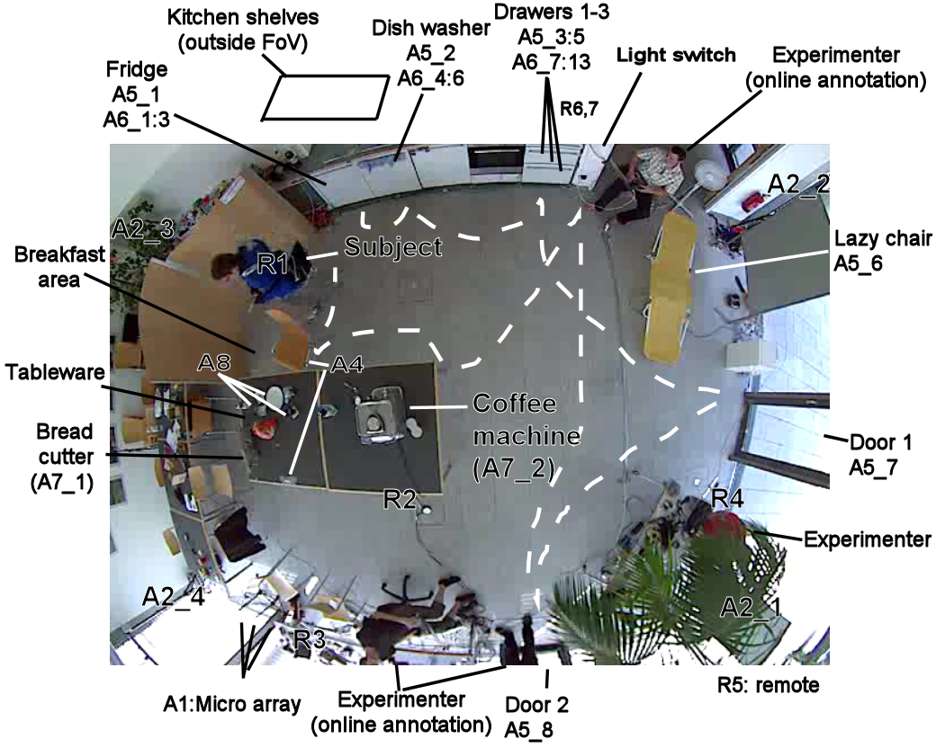
OPPORTUNITY DATASET
[1] R. Chavarriaga, H. Sagha, A. Calatroni, S. T. Digumarti, G. Tröster, J. del R. Millán, and D. Roggen, “The opportunity challenge: A benchmark database for on-body sensor-based activity recognition,” Pattern Recognition Letters, 2013.

Slide 5
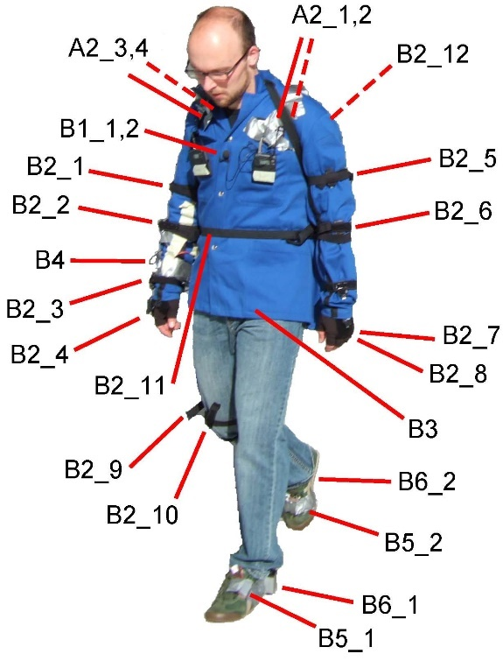
4 different subjects
7 Inertial Measurement Units
12 accelerometer sensors
113 channels of measurements
Data has been collected in two distinct modalities :
5 sessions of Activity of Daily Living (ADL)
Drill : 20 repetitions of low level activities

Slide 6
Multiclass Classification Problem
TASK A:
Classification of high level gestures / modes of locomotion
Standing, Walking, Lying, Sitting
TASK B2:
Recognition of low level gestures (17 in total)
Open Dishwasher, Close Dishwasher, Open Fridge, Close Fridge,
Open Drawer 1, Close Drawer 1, Open Door 1, Close Door 1, …
Both tasks comprehend the Null Class, which represents inactivity.
A more detailed discussion on this in a couple of slides

Slide 7
State of the Art
In the literature there’s no shortage of models trying to solve the problem. For example:
Complete framework in [2] that performs interpolation in preprocessing and tries to cope with class imbalances (1NN and SVM as classifiers)
Convolutional layers were implemented in NN along with ReLU and pooling layers in [3], in order to extract better features; they also segment the datasets into windows of samples
A complete comparison can be found in [4] were they also implement a model comprehensive of both convolutional and LSTM layers, in order to extract sensible features and exploit the correlation among consecutive samples and independent windows
[2] H. Cao, M. N. Nguyen, C. Phua, S. Krishnaswamy, and X. Li, “An integrated framework for human activity classification.,” in UbiComp,pp. 331–340, 2012.
[3] J. Yang, M. N. Nguyen, P. P. San, X. Li, and S. Krishnaswamy, “Deep convolutional neural networks on multichannel time series for human activity recognition.,” in Ijcai, vol. 15, pp. 3995–4001, 2015.
[4] F. Li, K. Shirahama, M. A. Nisar, L. Köping, and M. Grzegorzek, “Comparison of feature learning methods for human activity recognition using wearable sensors,” Sensors, vol. 18, no. 2, p. 679, 2018.

Slide 8
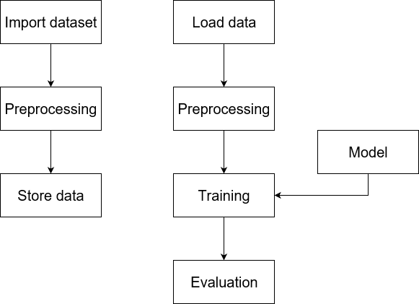
Processing Pipeline of Our Proposal
Matlab
Python

Slide 10
Conclusions
First step
Second step
Third step
Fourth step

Slide 11
Deep Learning Techniques for Gesture Recognition: Where to Split the Complexity
Matteo Drago, Riccardo Lincetto
Dept. of Information Engineering, University of Padova, Italy
Prof. Michele Rossi
matteo.drago@studenti.unipd.it
riccardo.lincetto@studenti.unipd.it
September, 5, 2018

